Slide 1

Urban Analytics: City Structure and Function
Alex Singleton
Professor of Geographic Information Science
University of Liverpool

Slide 2

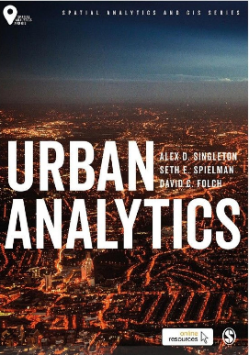





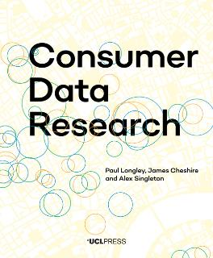






About Me
Alex Singleton
PhD
2007
2000-2003
2005
2010
2022
UG
KTP
Researcher
Lecturer / Reader / Chair
PhD pt.

Slide 3

Urban Analytics
The multi-disciplinary area of research concerned with using new and emerging forms of data, alongside computational and statistical techniques, to study cities.
The use of data and statistics in the study of cities is nothing new
What is new is the quantity and variety of data available about cities.
Create a range of challenges…
https://uk.sagepub.com/en-gb/eur/urban-analytics/book249267

Slide 4
Contents
New forms of Urban Data and the ESRC Consumer Data Research Centre (CDRC)
Case studies – Partnership Working and Impact
Linked Consumer Records
Geodemographics
London OAC
Internet User Classification
Retail

Slide 5



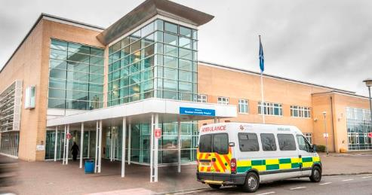
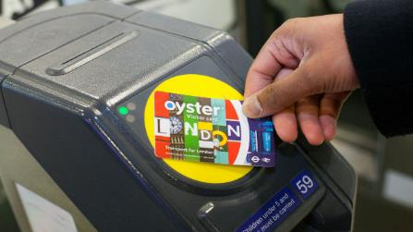
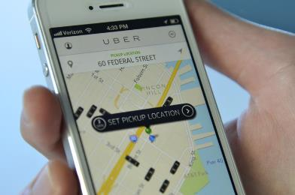
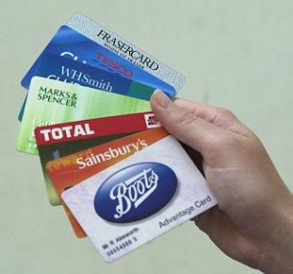

New Forms of Urban Data
No sample design
Collected by multiple organisations
Access to data can be complicated
Analysis of data can be difficult / time consuming

Slide 6
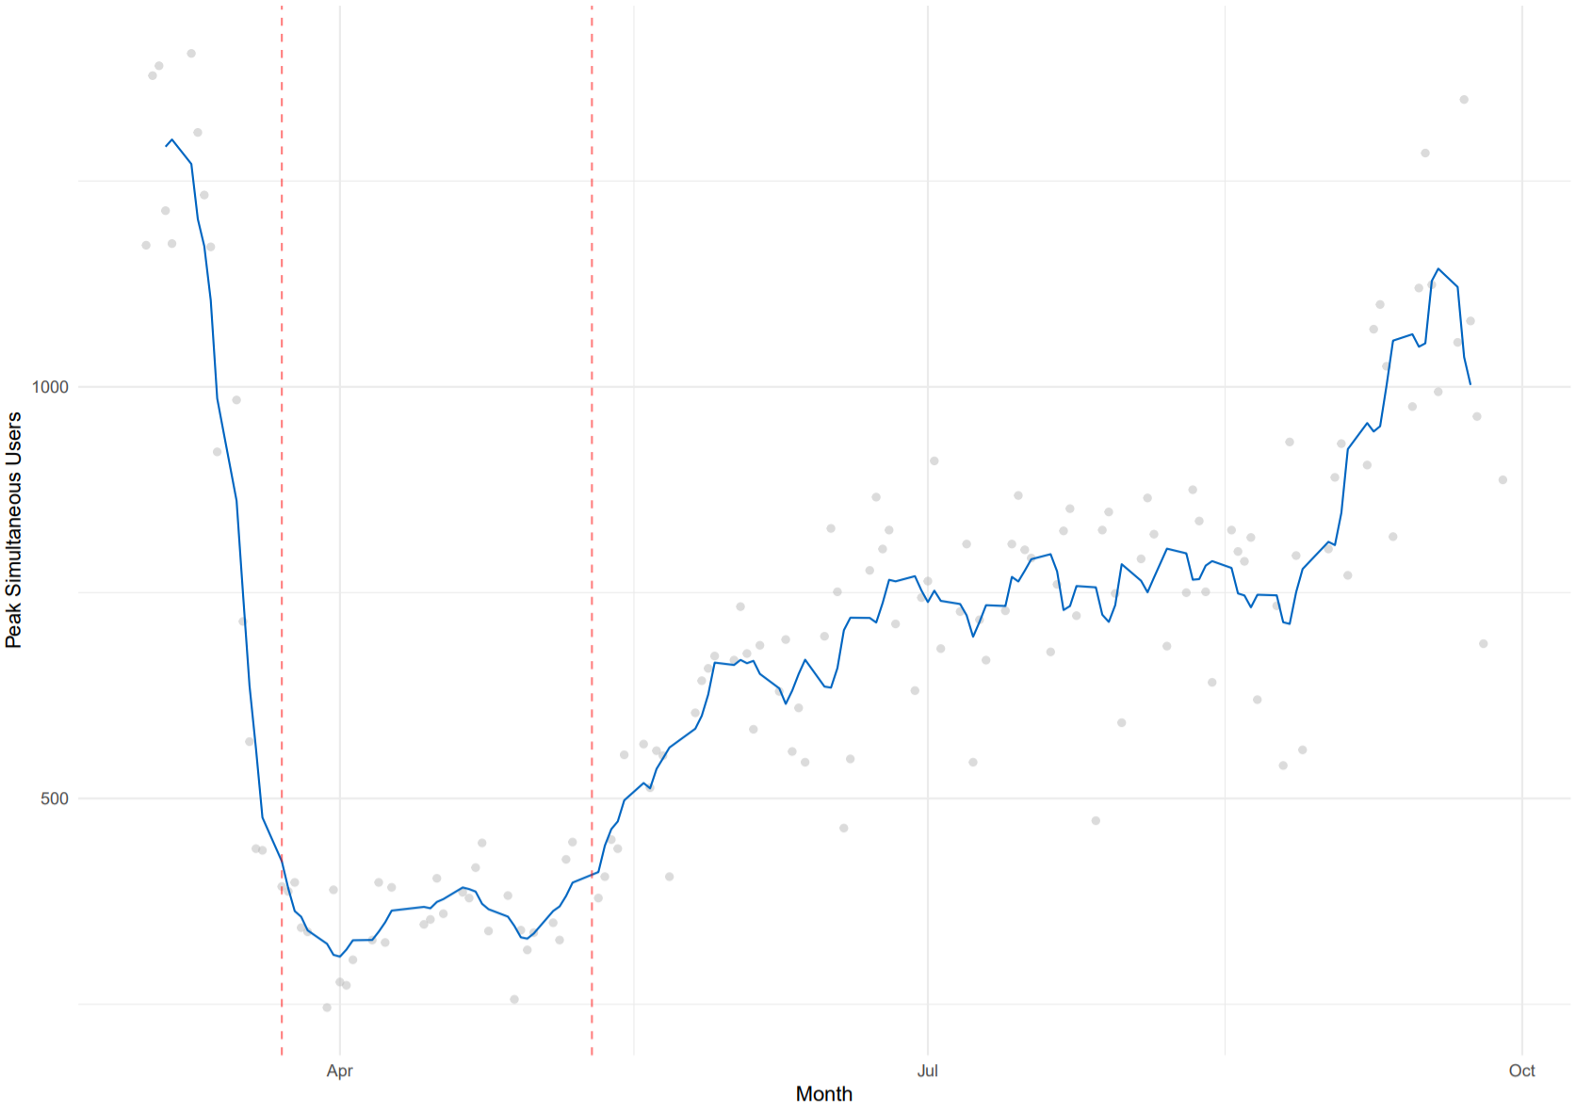

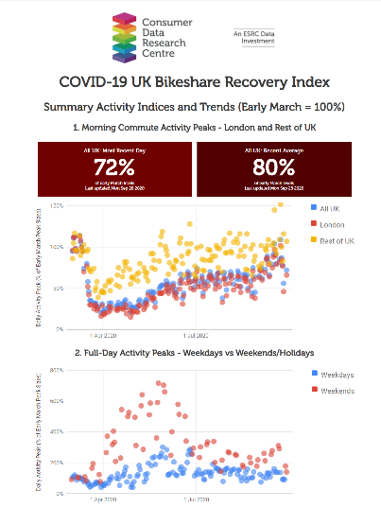
So why bother?
They can tell you things that you otherwise wouldn’t know or are complementary
Lockdown
"Stay Alert"
(May 10th)
AM Commute
https://apps.cdrc.ac.uk/bikeshareindex/

Slide 7

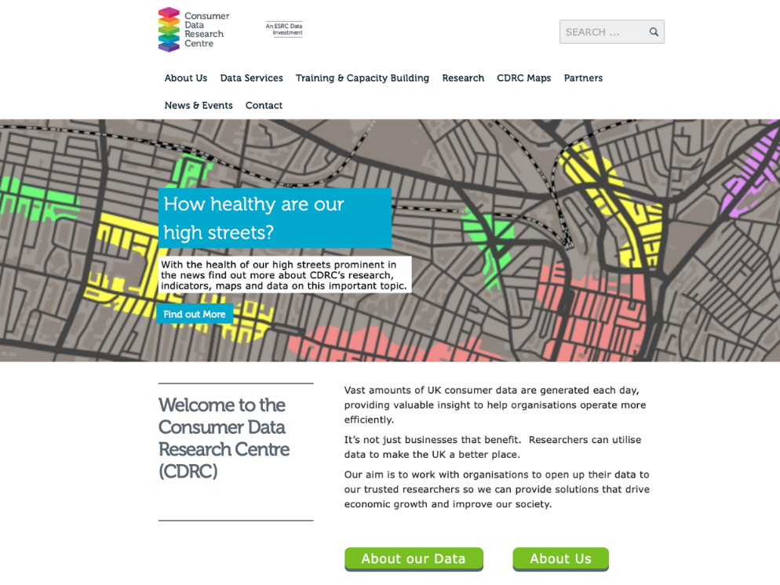
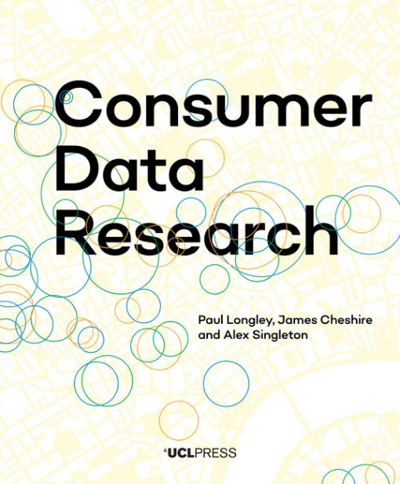




Funding emerged as a research council response to “Big Data”
Big Data Network II
Pitch – “Business Data”
Since 2014

Slide 8
Challenges
Legal
Agreements
Legal
Agreements
Data security
Lack of
Contacts
Data
Owners
Potential
Research Users
Risk…
Commercial
Sensitivity
Data
Discovery
Turning Big Data
Into Information

Slide 9
Benefits
Knowledge
Exchange
Unique or Complementary
Research Insights
Data
Owners
Potential
Research Users
Recruitment
Real World
Impact
Corporate
Responsibility
Partnership / Innovation
Potential

Slide 10
Our model
Data
Owners
Trust
Takes time…
Motivation for engagement
Assurance
Legal
Data Security (Service)
Data service
Secure
Efficient
Data Discoverability
Platforms
Analysis Ready Data
Potential
Research Users

Slide 11


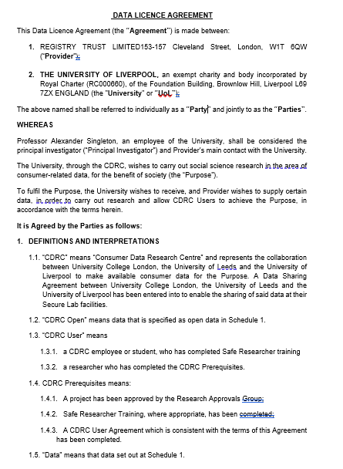




Assurance (Legal)
68 DLAs to date
https://www.google.com/url?sa=i&url=https%3A%2F%2Fwww.cdrc.ac.uk%2F&psig=AOvVaw3DHfGTFEKKSktFJzG_gld9&ust=1601548498594000&source=images&cd=vfe&ved=0CAIQjRxqFwoTCKCwgJ3XkOwCFQAAAAAdAAAAABAD

Slide 12
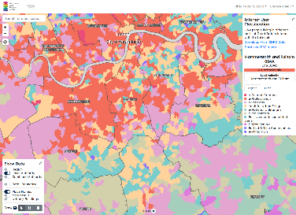

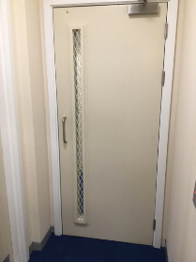

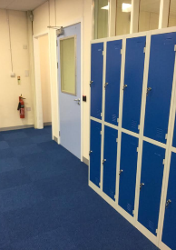
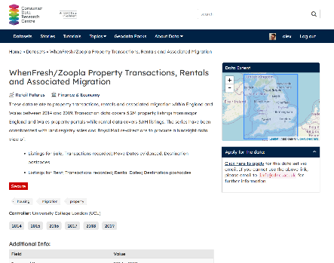
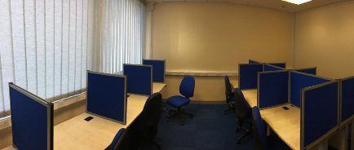

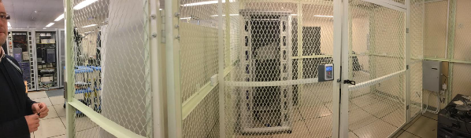
Assurance (Data Service)
Open
Safeguarded
Secure
ISO27001
+ API (General, Ethnicity Estimator)
Research Approvals Process

Slide 13
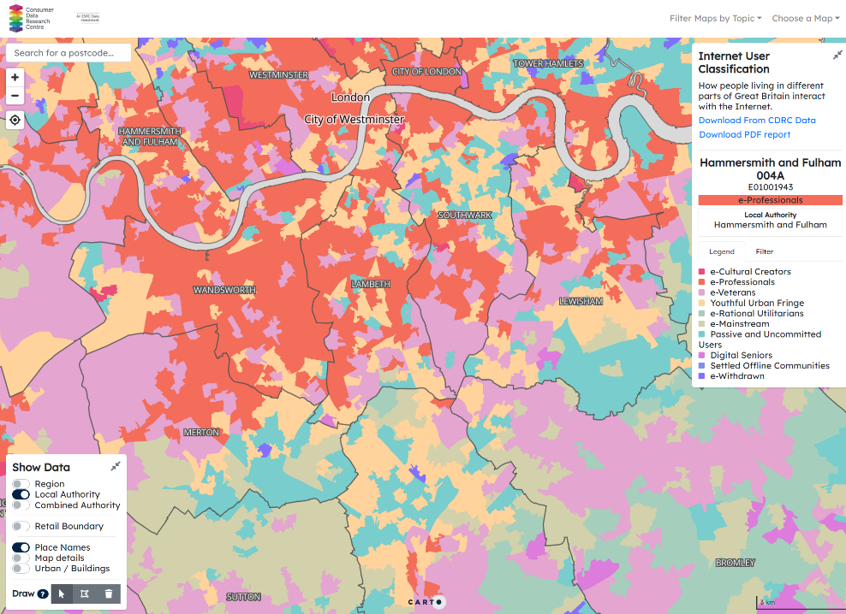

Discoverability
mapmaker.cdrc.ac.uk
data.cdrc.ac.uk

Slide 14

Motivation for Engagement
Data Collaborations
Data Sharing Agreements
Ladder of engagement
Data Science Projects
PhD Sponsorship
Training / Workshops
Data Partners Forum
Alumni Network /
Event
Master Dissertation Scheme

Slide 15



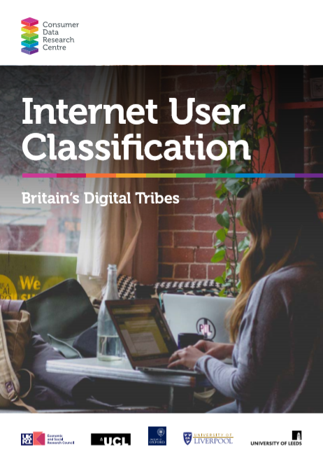
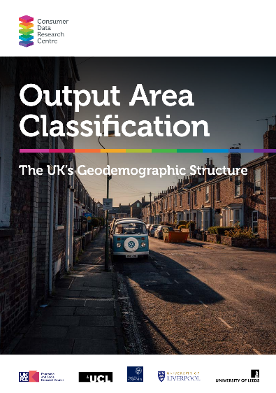

Analysis Ready Data Products
Higher
Open
User
Demand
Safeguarded
Secure
Lower
Lower
Higher
Skills Required
to Access

Slide 16
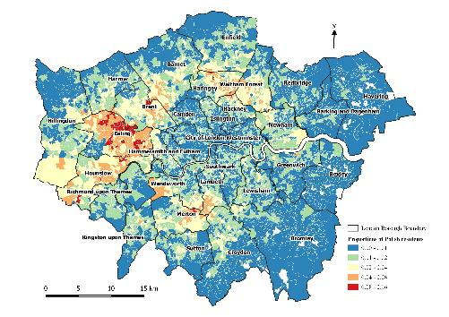
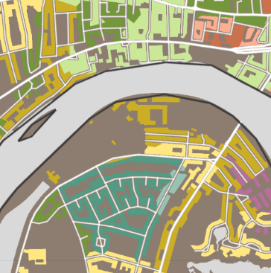
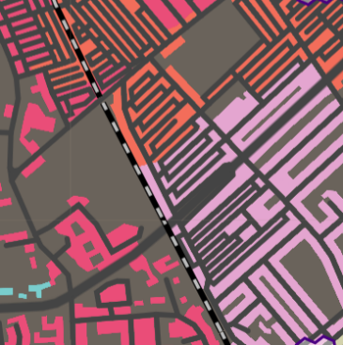
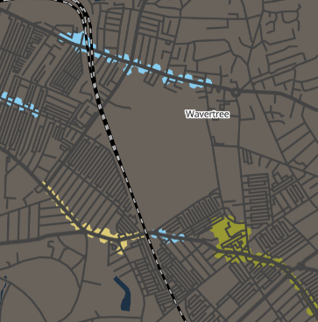





Analysis Ready Data Case Studies
Geodemographics
Linked Consumer
Registers
London Output
Area Classification
Internet
User Classification
Retail

Slide 17
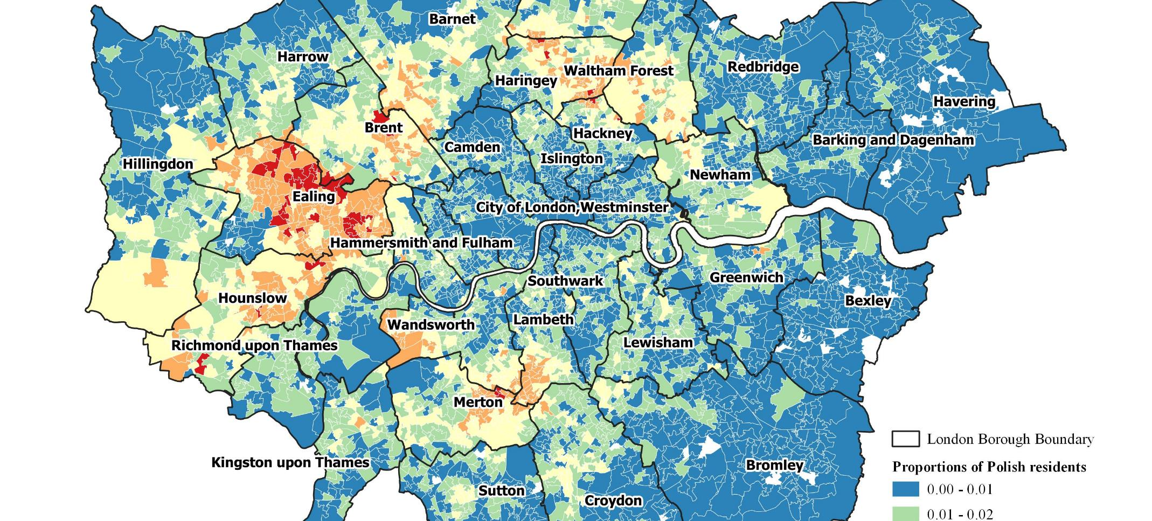
Linked Consumer Registers

Slide 18
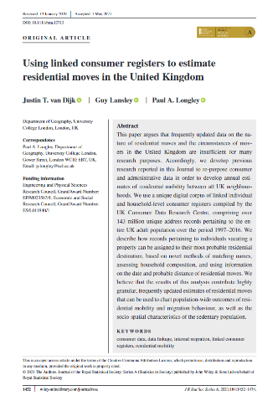
Linked Consumer Records
Sources:
Electoral Roll (public)
Other commercial sources / surveys
Links
Individuals
Houses
Households
Year | Last observation | First observation
1997 | 6,209,906 | 45,342,404
1998 | 6,065,950 | 8,123,676
1999 | 8,142,354 | 6,528,756
2000 | 4,045,262 | 8,437,748
2001 | 6,288,883 | 3,055,384
2002 | 5,744,780 | 7,433,461
2003 | 5,001,650 | 5,099,172
2004 | 5,578,480 | 4,553,431
2005 | 5,108,975 | 4,665,936
2006 | 3,979,450 | 4,793,242
2007 | 3,542,251 | 4,698,893
2008 | 4,438,117 | 3,654,831
2009 | 5,325,528 | 6,003,444
2010 | 6,727,176 | 6,203,975
2011 | 13,744,674 | 4,779,294
2012 | 7,575,166 | 5,016,716
2013 | 6,415,383 | 6,292,786
2014 | 6,586,815 | 2,111,463
2015 | 6,814,220 | 2,409,062
2016 | 26,454,029 | 4,585,375
… | … | …
2021 | … | …
data.cdrc.ac.uk/dataset/linked-consumer-register

Slide 19
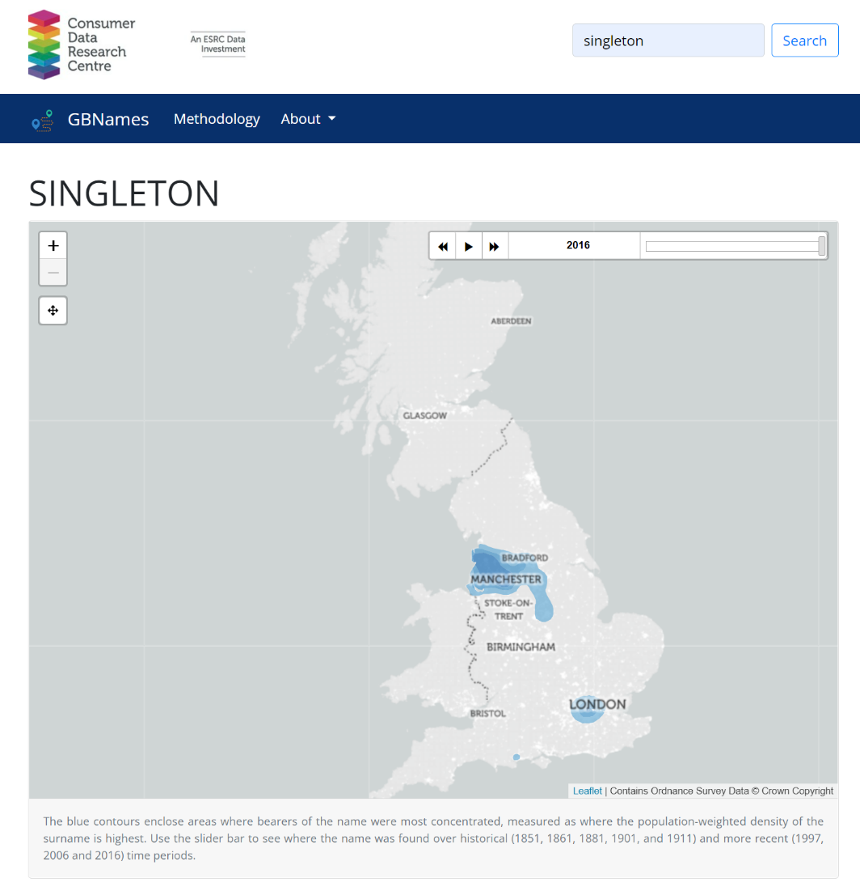
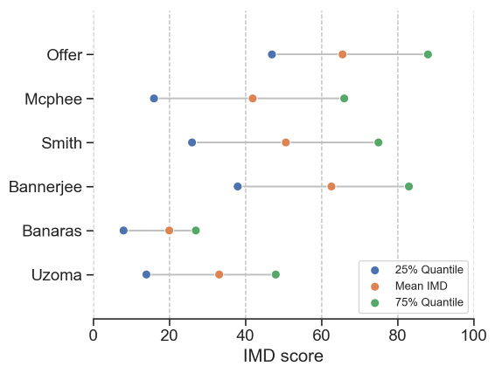
Geography and Names
apps.cdrc.ac.uk/gbnames

Slide 20
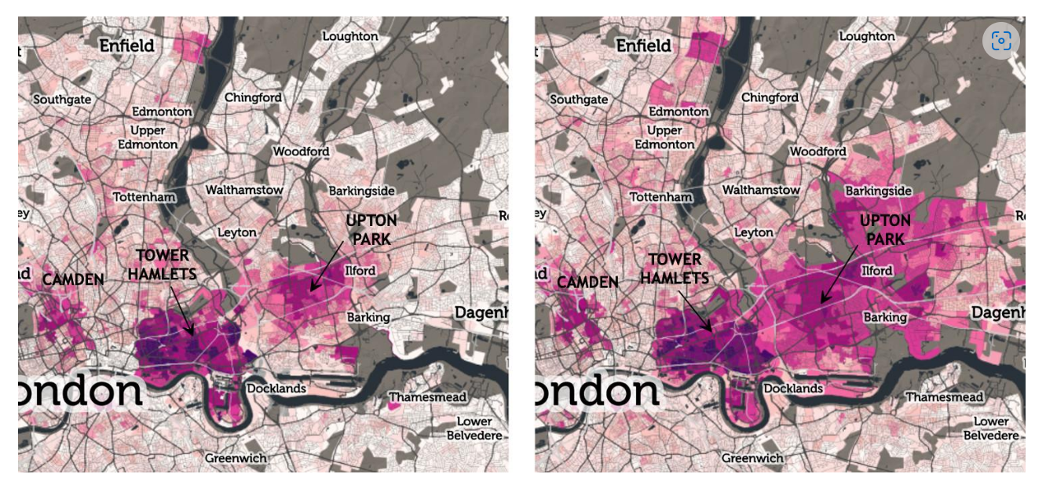
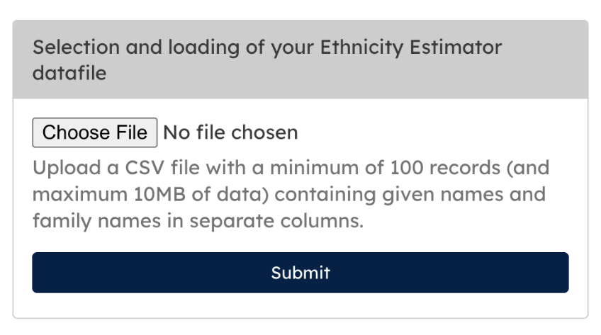
Names and Geography
Working with the ONS, developed a tool that can predict ethnicity (Census Categories) from names
Append to areas
1998
2016
Eastward movement of individuals of Bangladeshi origin from Tower Hamlets

Slide 21
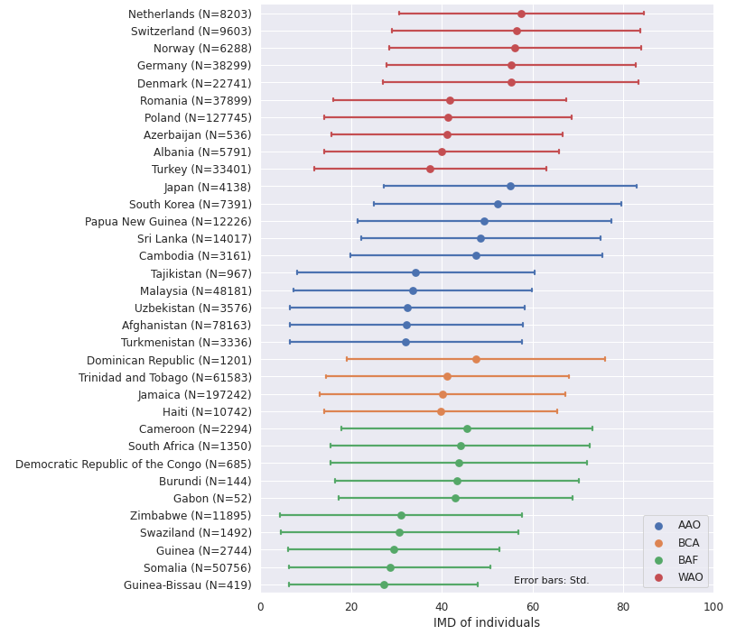
Names, Ethnicity and IMD
Disparities between ethnic groups but
Limitations of widely-used ethnicity classifications
Heterogeneity within groups

Slide 22

Ethnicity and the first COVID-19 epidemic wave in Wales
Identify ethnic differences in proportions with COVID-19 during the first epidemic wave in Wales
Tested positive
Hospitalised
Admitted to intensive care
Died in hospital
Higher proportion of black, Asian and ethnic minority people tested positive
Hospitalised black, Asian and minority ethnic cases were younger and more likely to be admitted to intensive care
In Wales, older age and male gender, but not ethnicity, were associated with death in hospitalised patients.

Slide 23

Takeaway
Example of consumer data telling you new things
Enhancing temporal granularity and complementing alternative sources

Slide 24
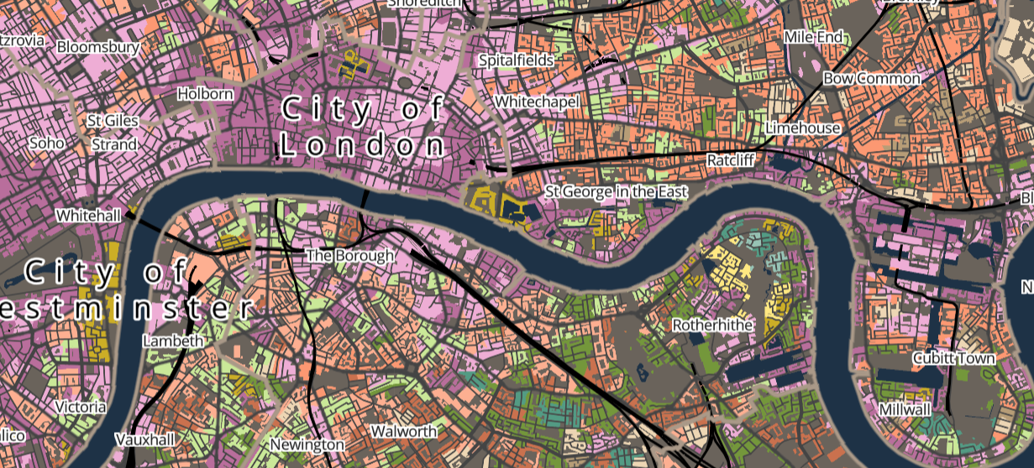
London Output Area Classification

Slide 25
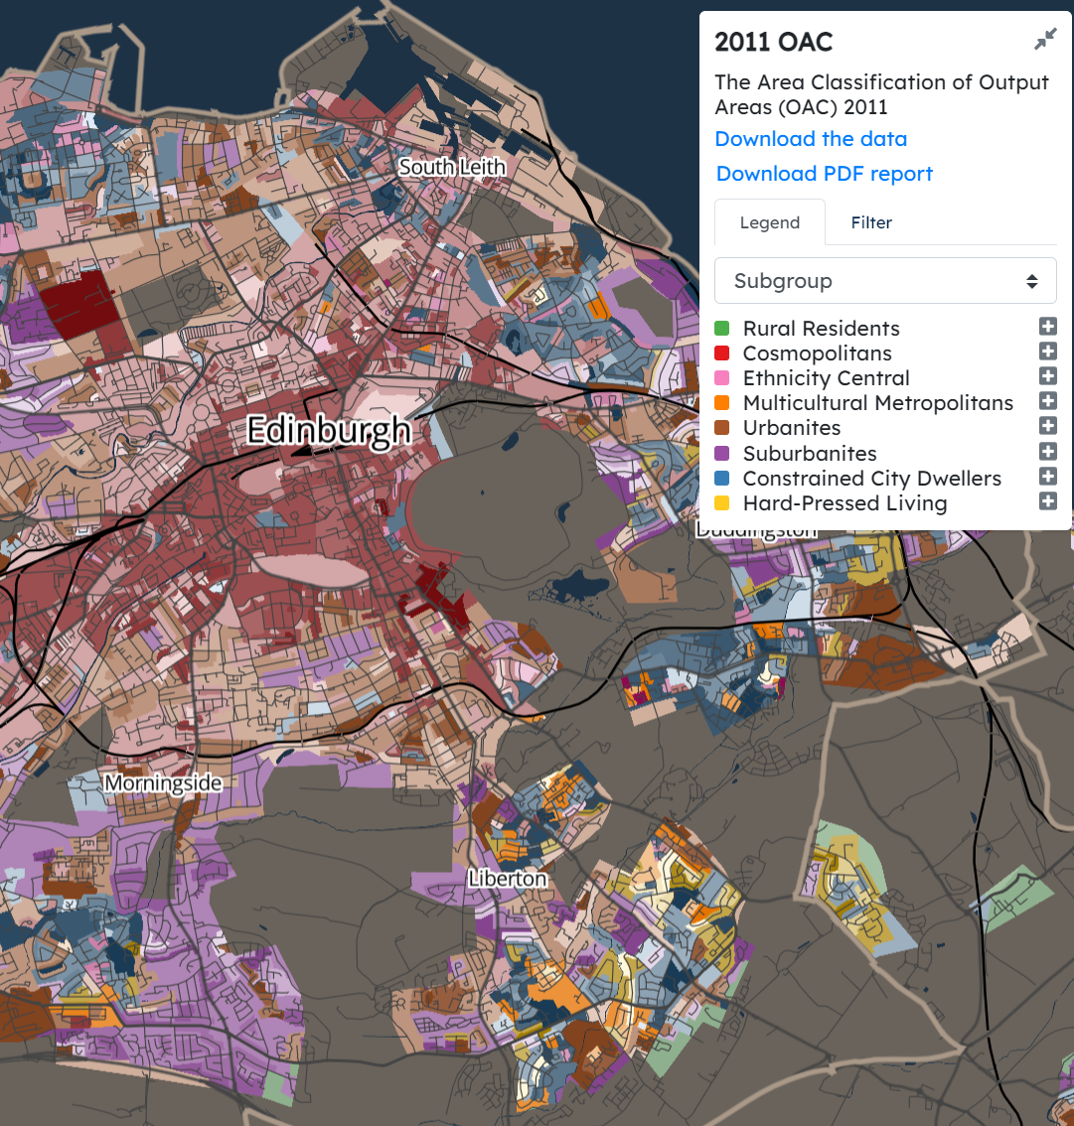
What is a Geodemographic?
OA | Variables
E00000001
E00000003
E00000005
E00000007
E00000010
E00000012
E00000013
E00000014
E00000016
E00000017
E00000018
E00000019
E00000020
E00000021
E00000022
E00000023
… | …
Transform
(Normalise,
Standardise)
Cluster
Analysis
Describe
https://mapmaker.cdrc.ac.uk/#/output-area-classification

Slide 26
LOAC V OAC

Slide 27
Input Data & Method
Domain | Sub Domain | Variables
Demographic | Age Structure | Age bands
 | Family Structure | Marriage; children; dependant children;
 | Ethnicity | Ethnic Groups; Spoken English; EU V New EU
Housing | Composition | Density; communal establishment; student household; occupancy rating
 | Type | Detached, semi, terrace, flats
 | Tennure | Socially rented; private rented; owned or shared ownership
Socio-Economic | Health | Day-to-day activities limited a lot or a little; standardised illness ratio
 | Employment | Unemployment; full time; part time
 | Occupation | Occupation groups
 | Education | Level 1; Level 2; Level 3; Level 4+
 | Mobility | Car ownership; private transport; public transport; active transport
Mirror OAC 2011
% scores and ratio
Range (0-1)
K-means (8, 21)

Slide 28
London Output Area Classification
Intermediate Lifestyles
High Density and High Rise Flats
Settled Asians
Urban Elites
City Vibe
London Life-Cycle
Multi-Ethnic Suburbs
Aging City Fringe
https://data.cdrc.ac.uk/dataset/london-oac-2011

Slide 29
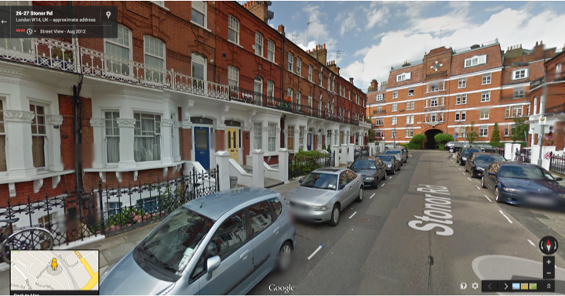
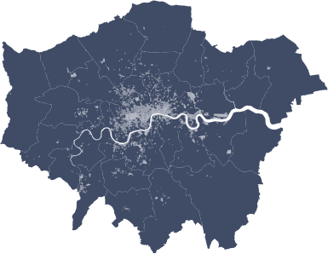
D: Urban Elites
Young professionals
Working in the science, technology, finance and insurance sectors. Large numbers of students
Many privately owned flats
Residents are disproportionately drawn from pre 2001 EU countries,
High of Chinese, Arab and other minority backgrounds.
Groups
D1 Educational advantage
D2 City central
E00009327; Stoner Road, West Kensington

Slide 30
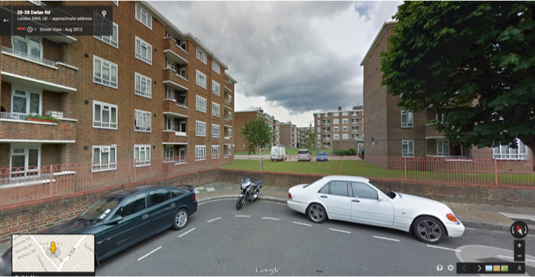
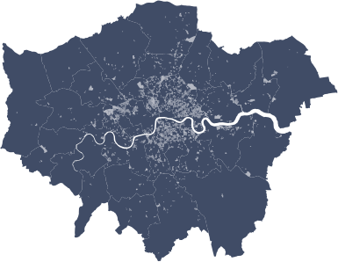
B: High Density and High Rise Flats
Densely populated areas of flats.
Families have children of school age
Many residents Bangladeshi origins
High Black residents or Mixed or Other ethnic groups.
Higher spoken language is not English.
Qualifications are below the London average
Some residents are full-time students living in shared accommodation.
Levels of unemployment and part-time working high
Employment more typically in administration, or in accommodation and food services industries.
Groups
B1 Disadvantaged diaspora
B2 Bangladeshi enclaves
E00009768; Lancaster Court, Fulham

Slide 31
Transport Classification of Londoners
London Travel Demand Survey data from 2012-15 – this is an annual household travel survey carried out with over 8,000 London households each year.
Segmentation survey data from 2015 – this was a bespoke survey with more than 5,000 individuals across London collecting information on travel behaviours, preferences and attitudes.
Appended to LOAC - Sub Groups were then grouped on the basis of these variables to form the TCoL segments

Slide 32
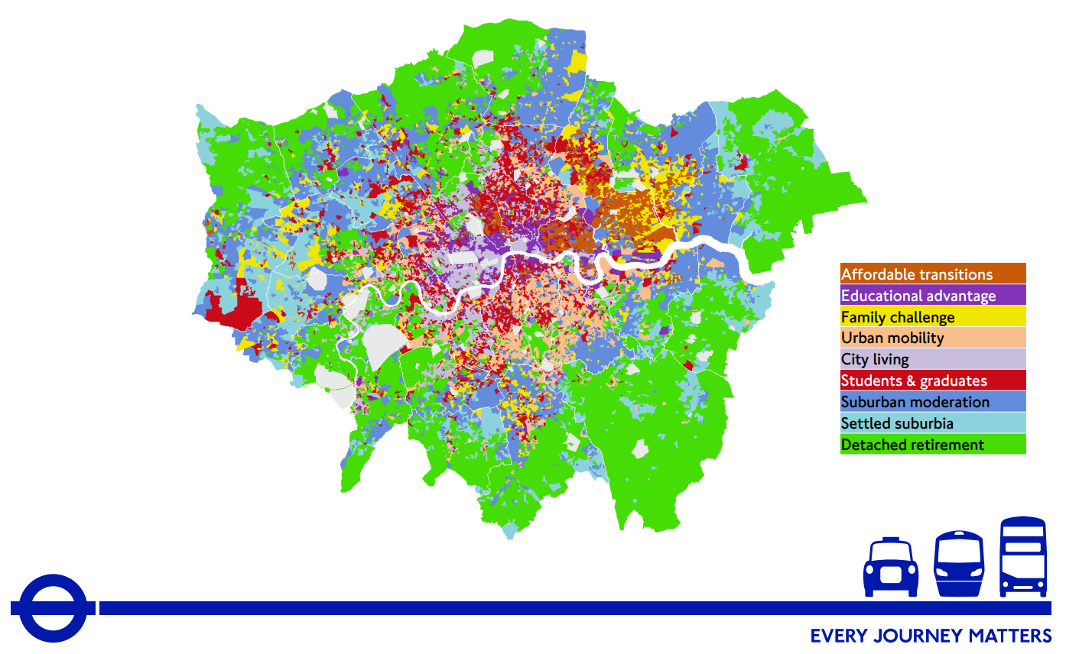

Transport Classification of Londoners

Slide 33

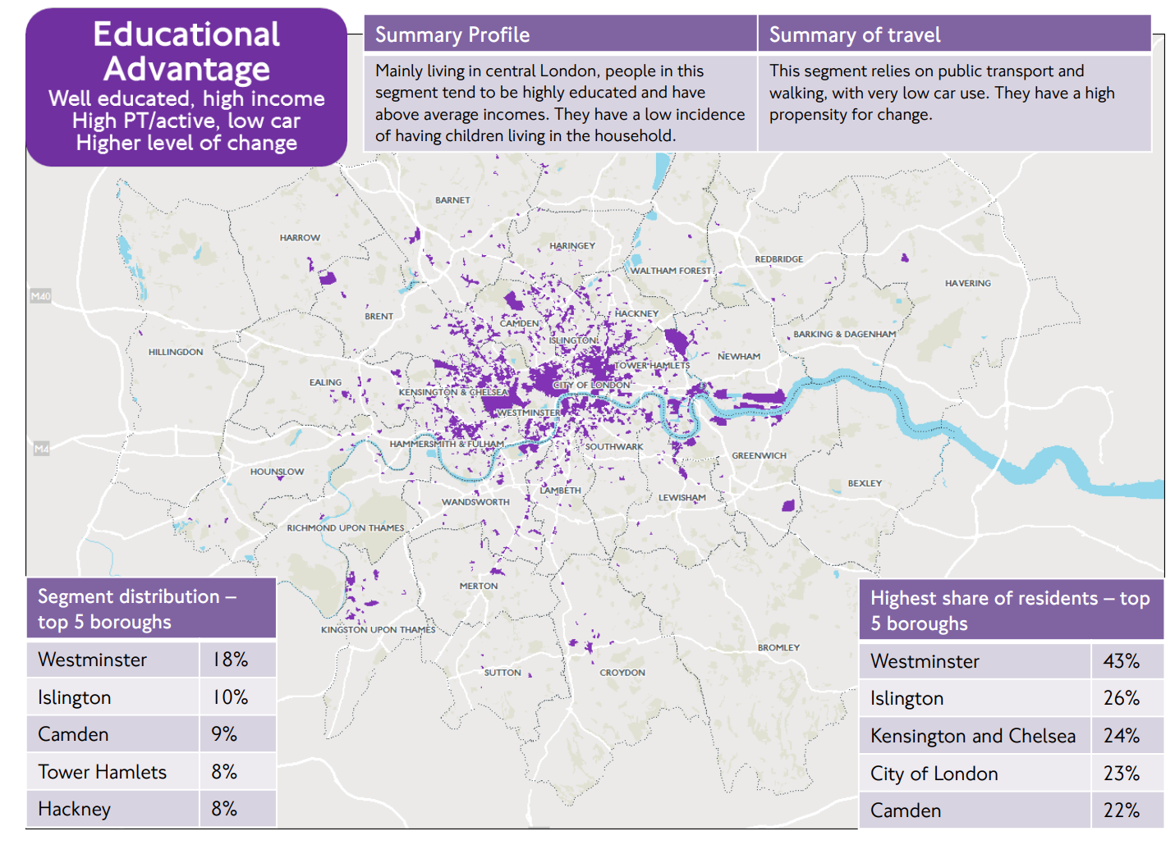

Slide 34
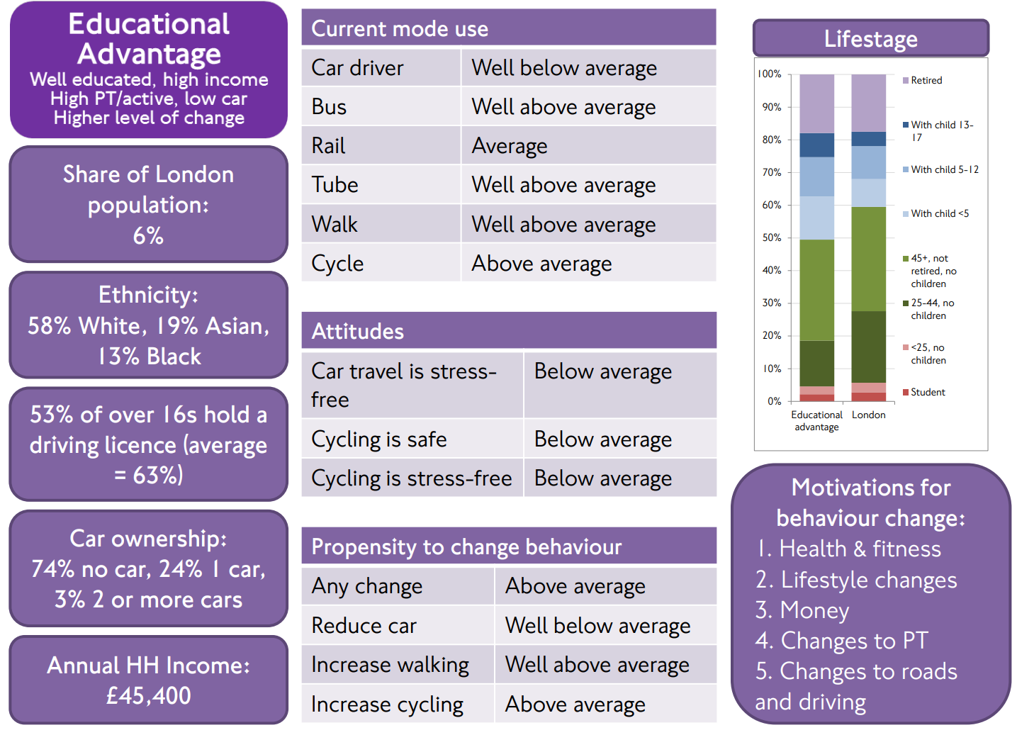

Slide 35

Underpinned five reports that examined walking and cycling behaviour and strategies for increasing modal shift & integrated into a new cycling model / planning toolkit.
Integrated into TfL’s “Healthy Streets Check” to ensure streets meet TfL’s targets for improving sustainable travel. ” Since 2019, the check has been applied to all investments, irrespective of size.
“Liveable Neighbourhoods Scheme” (since 2017 - offers grants of up to £10M for borough-level projects. TCoL is used to help assess proposed projects according to the expected improvement delivered. The most recent round of this scheme corresponded to £53M of TfL funding.

Slide 36
Takeaway
Example of consumer data complementing and enhancing traditional sources of data
Basic extension (wrapper around a geodemographic model)

Slide 37
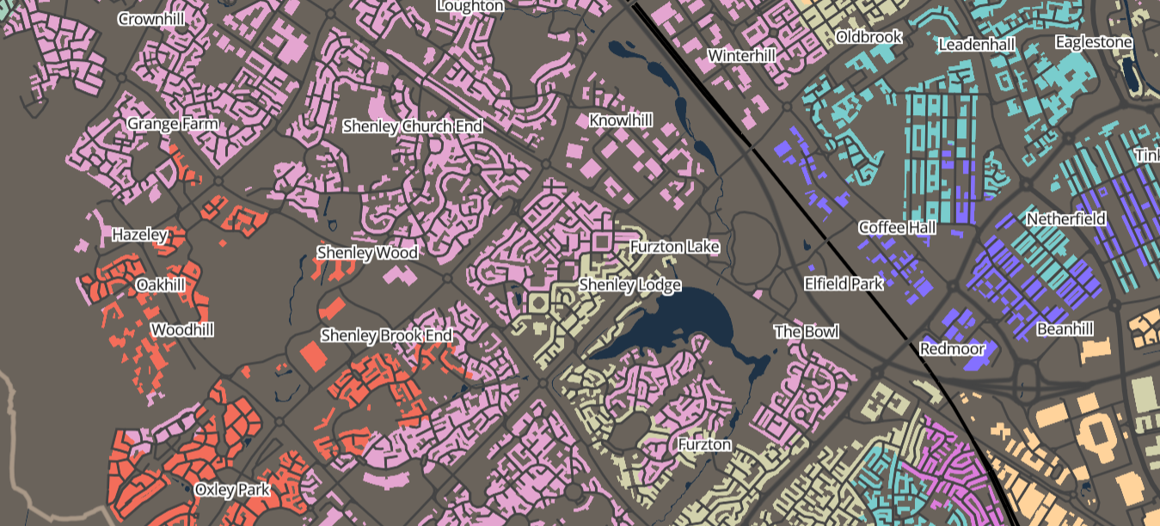
Internet User Classification

Slide 38
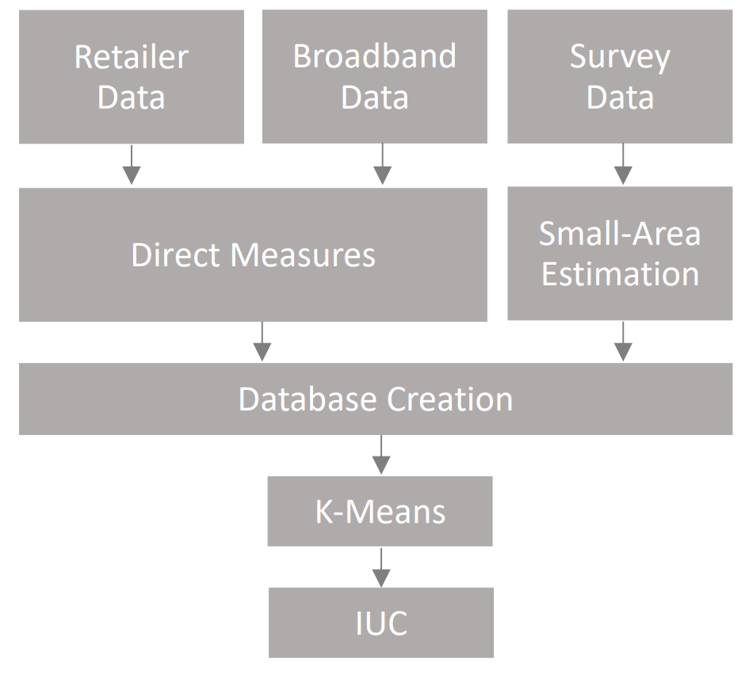
Mapping Digital Inequality
Digital inequality is observable where access to online resources and those opportunities that these create are non-egalitarian.
Often Geographic

Slide 39
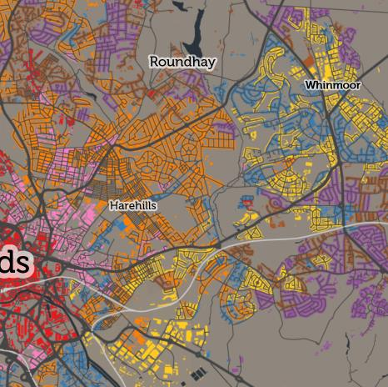
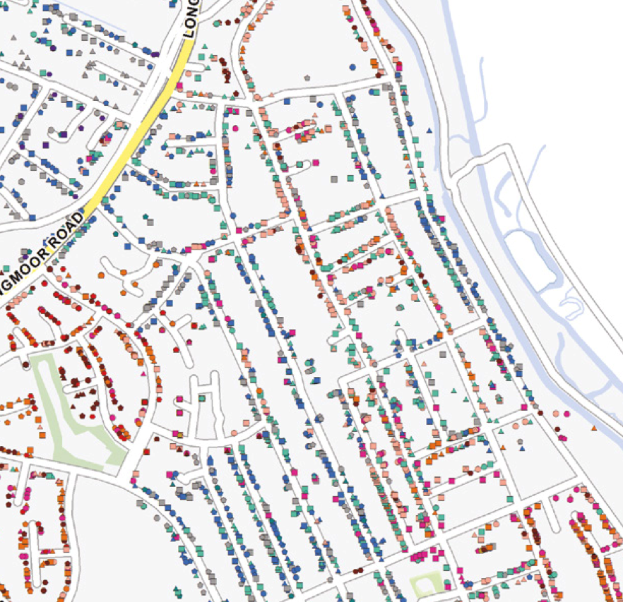
Open V Closed Geodemographics

Slide 40
Hybrid Geodemographics
Inputs
Output
Open
Data
Secure
Setting
Open
Product
Model Building
Small area
Estimates
Survey
Data
Controlled
Product
Retailer Data
Controlled
Setting
Controlled
Setting
Blended Approach

Slide 41
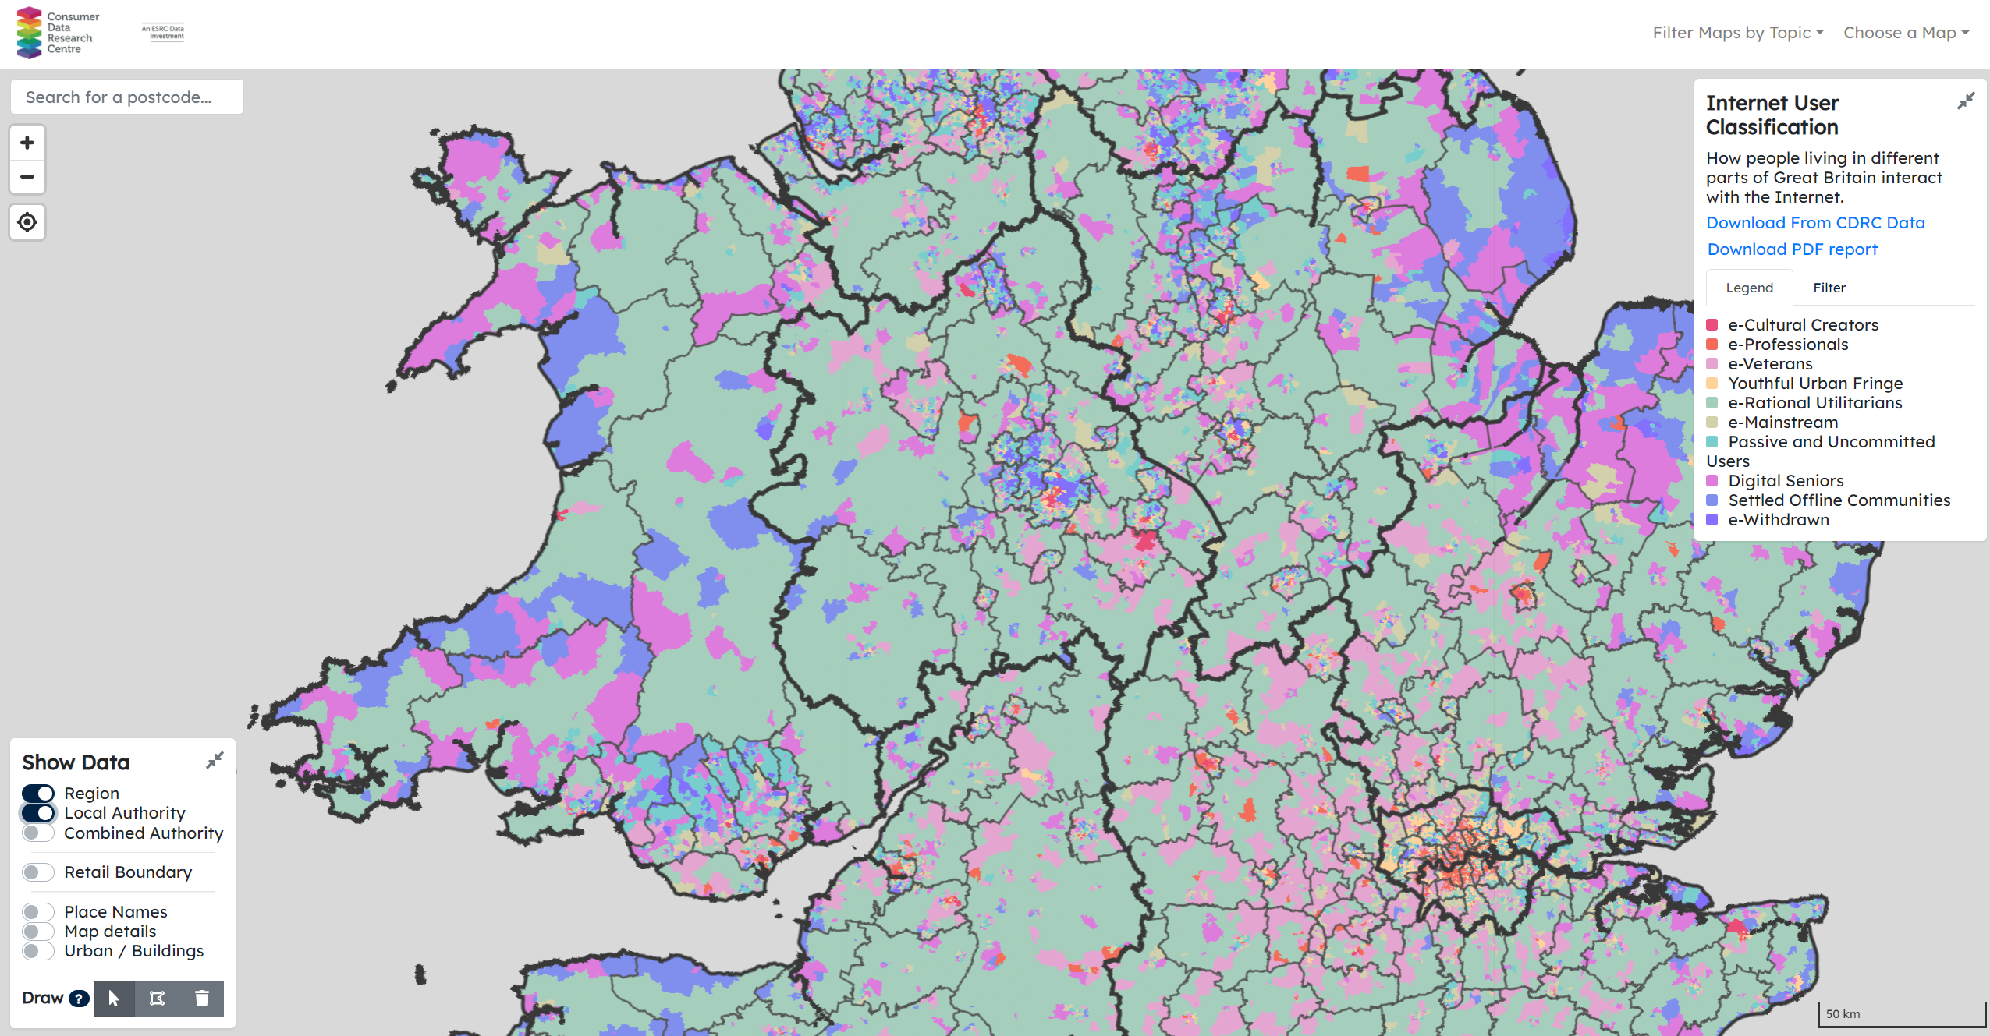

mapmaker.cdrc.ac.uk

Slide 42
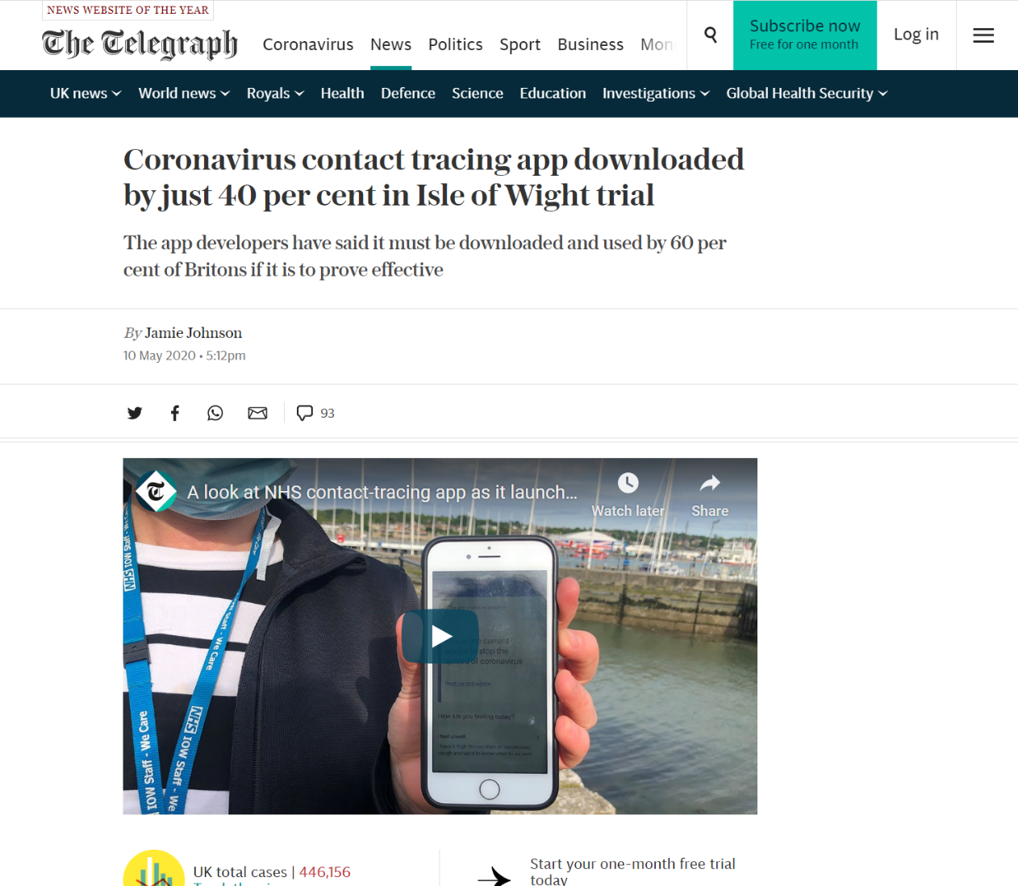
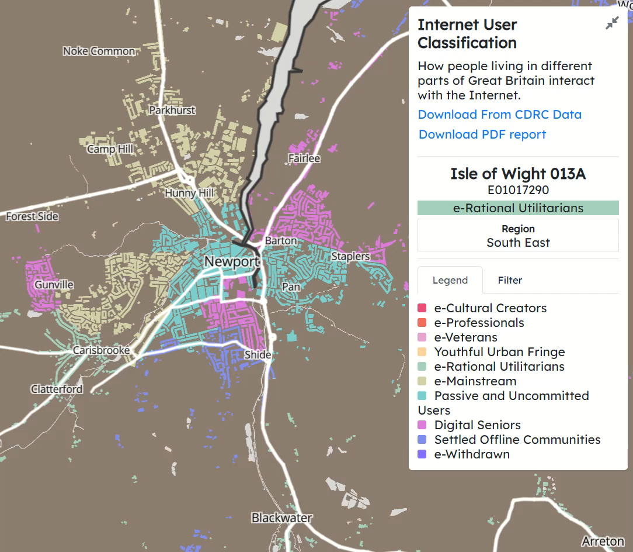
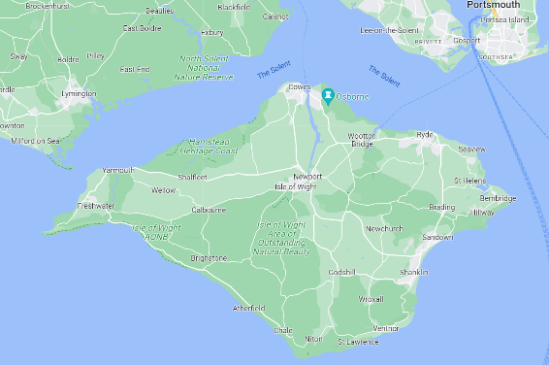

Slide 43
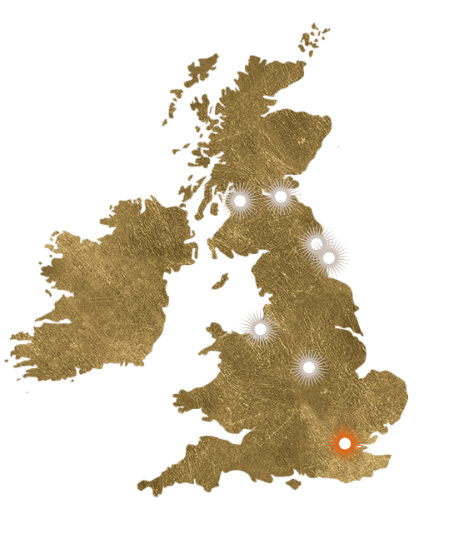
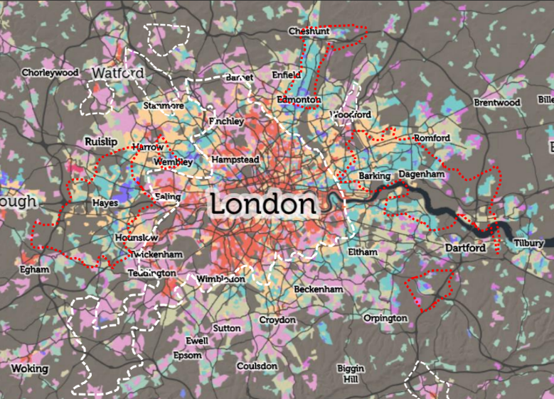

Book of Mormon
Email from the Marketing Director for Book of Mormon in 2018…
Strong correspondence between patrons and the IUC
Marketing – Outdoor Advertising… mobile populations

Slide 44





Book of Mormon

Slide 45
Takeaway
Example of consumer data telling you things that you otherwise wouldn’t know.
Complementing and enhancing traditional sources of data
Infrastructure is critical – for creation and promotion

Slide 46

Retail

Slide 47

Challenge & Objective
Where and what is a retail centre?
Why?
Important - Multi Function
Change over time

Slide 48
Data on Retail Locations
Valuation Office Agency Data
Open Street Map
Retailer X,
123 Nowhere Street,
Liverpool,
L1 1PD
Retailer X
Nowhere street

Slide 49

UK Address Geocoding
L18 2DD

Slide 50


Where
https://h3geo.org/

Slide 51


Where
Gather a list of H3 for every POI
Remove isolated H3
Apply padding from OSM
Remove centres with less that 10 retailers

Slide 52

Who
Walk and drive time catchments for the larger centres
Enable the exploration of the characteristics of demand as well as supply

Slide 53

Retail Indicators
Created a variety of indicators:
Deprivation
“Clone Town” measure
E-Resilience Index

Slide 54




Future Highstreets Taskforce

Slide 55
Takeaway
Example of consumer data telling you things that you otherwise wouldn’t know.
Blending new forms of data to tell new stories.

Slide 56
Conclusions…
Consumer data adds value to urban geography and planning research by
Telling you new things
Complementing existing sources
Relies on infrastructure
Analysis
Promotion
Integration and support has a lot of Impact potential

